Slide 1
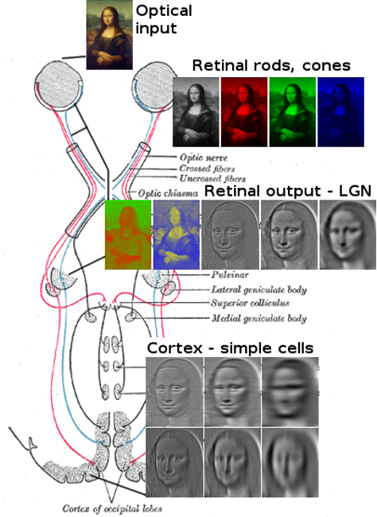
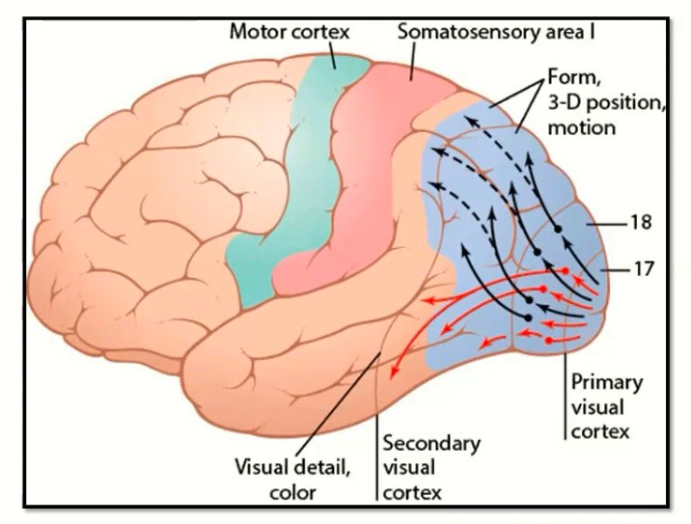
Our Brains are amazing at Vision
The visual cortex (located in the occipital lobe) is the primary cortical region of the brain that receives, integrates, and processes visual information relayed from the retinas

Slide 2
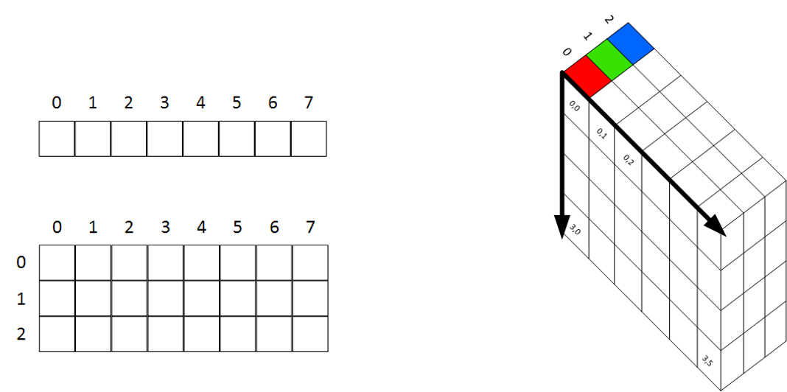
Digital Images Format
Images are stored in Multi-Dimensional Arrays
•
A 1-Dimensional array looks like this
•
A 2-Dimensional array looks like this
•
A 3-Dimensional array looks like this

Slide 3
Convolutional Neural Networks

Slide 4
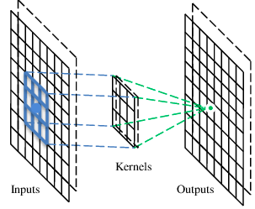
A convolutional layer
A CNN is a neural network with some convolutional layers
(and some other layers). A convolutional layer has a number
of filters that does convolutional operation.

Slide 5
Example of a Convolution Operation
1 | 0 | 1 | 0 | 1
1 | 0 | 0 | 1 | 1
0 | 1 | 1 | 0 | 0
1 | 0 | 0 | 1 | 0
0 | 0 | 1 | 1 | 0
0 | 1 | 0
1 | 0 | -1
0 | 1 | 0
2 | 1 | -1
-1 | 1 | 3
2 | 1 | 1
*
=
Input Image
Filter or Kernel
Output or Feature Map

Slide 6
Example of a Convolution Operation
(1 × 0) + (0 × 1) + (1 × 0) + (1 × 1) + (0 × 0) + (0 × −1) + (0 × 0) + (1 × 1) + (1 × 0) = 2
 |  |  |  |  |  |  |  |  | 0 | 1
1x0 |  |  | 0x | 1 |  | 1x | 0
1x1 |  |  | 0x | 0 |  | 0x | -1 |  | 1 | 1
0x | 0 |  | 1x1 |  |  | 1x | 0 |  | 0 | 0
1 |  |  | 0 |  |  | 0 |  |  | 1 | 0
0 |  |  | 0 |  |  | 1 |  |  | 1 | 0
0 | 1 | 0
1 | 0 | -1
0 | 1 | 0
2
*
=
Input Image
Filter or Kernel
Output or Feature Map

Slide 7
Example of a Convolution Operation
(0 × 0) + (1 × 1) + (0 × 0) + (0 × 1) + (0 × 0) + (1 × −1) + (1 × 0) + (1 × 1) + (0 × 0) = 1
1 | 0x0 | 1x1 | 0x0 | 1
1 | 0x1 | 0x0 | 1x-1 | 1
0 | 1x0 | 1x1 | 0x0 | 0
1 | 0 | 0 | 1 | 0
0 | 0 | 1 | 1 | 0
0 | 1 | 0
1 | 0 | -1
0 | 1 | 0
2 | 1
*
=
Input Image
Filter or Kernel
Output or Feature Map

Slide 8
Example of a Convolution Operation
1 | 0 | 1 | 0 | 1
1 | 0 | 0 | 1 | 1
0 | 1 | 1 | 0 | 0
1 | 0 | 0 | 1 | 0
0 | 0 | 1 | 1 | 0
0 | 1 | 0
1 | 0 | -1
0 | 1 | 0
2 | 1 | -1
*
=
Input Image
Filter or Kernel
Output or Feature Map

Slide 9
Example of a Convolution Operation
1 | 0 | 1 | 0 | 1
1 | 0 | 0 | 1 | 1
0 | 1 | 1 | 0 | 0
1 | 0 | 0 | 1 | 0
0 | 0 | 1 | 1 | 0
0 | 1 | 0
1 | 0 | -1
0 | 1 | 0
2 | 1 | -1
-1
*
=
Input Image
Filter or Kernel
Output or Feature Map

Slide 10
Example of a Convolution Operation
1 | 0 | 1 | 0 | 1
1 | 0 | 0 | 1 | 1
0 | 1 | 1 | 0 | 0
1 | 0 | 0 | 1 | 0
0 | 0 | 1 | 1 | 0
0 | 1 | 0
1 | 0 | -1
0 | 1 | 0
2 | 1 | -1
-1 | 1
*
=
Input Image
Filter or Kernel
Output or Feature Map

Slide 11
Example of a Convolution Operation
1 | 0 | 1 | 0 | 1
1 | 0 | 0 | 1 | 1
0 | 1 | 1 | 0 | 0
1 | 0 | 0 | 1 | 0
0 | 0 | 1 | 1 | 0
0 | 1 | 0
1 | 0 | -1
0 | 1 | 0
2 | 1 | -1
-1 | 1 | 3
*
=
Input Image
Filter or Kernel
Output or Feature Map

Slide 12
Example of a Convolution Operation
1 | 0 | 1 | 0 | 1
1 | 0 | 0 | 1 | 1
0 | 1 | 1 | 0 | 0
1 | 0 | 0 | 1 | 0
0 | 0 | 1 | 1 | 0
0 | 1 | 0
1 | 0 | -1
0 | 1 | 0
2 | 1 | -1
-1 | 1 | 3
2
*
=
Input Image
Filter or Kernel
Output or Feature Map

Slide 13
Example of a Convolution Operation
1 | 0 | 1 | 0 | 1
1 | 0 | 0 | 1 | 1
0 | 1 | 1 | 0 | 0
1 | 0 | 0 | 1 | 0
0 | 0 | 1 | 1 | 0
0 | 1 | 0
1 | 0 | -1
0 | 1 | 0
2 | 1 | -1
-1 | 1 | 3
2 | 1
*
=
Input Image
Filter or Kernel
Output or Feature Map

Slide 14
Example of a Convolution Operation
1 | 0 | 1 | 0 | 1
1 | 0 | 0 | 1 | 1
0 | 1 | 1 | 0 | 0
1 | 0 | 0 | 1 | 0
0 | 0 | 1 | 1 | 0
0 | 1 | 0
1 | 0 | -1
0 | 1 | 0
2 | 1 | -1
-1 | 1 | 3
2 | 1 | 1
*
=
Input Image
Filter or Kernel
Output or Feature Map

Slide 15
Convolution Operations on Color Images
Color image: RGB 3 channels
1 | -1 | -1
-1 | 1 | -1
-1 | -1 | 1
-1 | 1 | -1
-1 | 1 | -1
-1 | 1 | -1
1 | -1 | -1
-1 | 1 | -1
-1 | -1 | 1
-1 | 1 | -1
-1 | 1 | -1
-1 | 1 | -1
1 | -1 | -1
-1 | 1 | -1
-1 | -1 | 1
-1 | 1 | -1
-1 | 1 | -1
-1 | 1 | -1
Sum all the numbers to get the Feature Map Output
Filter 1
Filter 2
1
1
0
0
0
1
1
0
0
0
1
1
1
0
0
0
1
0
0
0
1
0 -
1
3 | 3 | 0
3 | 3 | 0
3 | 3 | 0
0
-1
1
1
0
0
0
1 | 0 | 0 | 0 | 0 | 1
0 | 1 | 0 | 0 | 1 | 0
0 | 0 | 1 | 1 | 0 | 0
1 | 0 | 0 | 0 | 1 | 0
0 | 1 | 0 | 0 | 1 | 0
0 | 0 | 1 | 0 | 1 | 0
1
1
0
0
0
1
1 | 0 | 0 | 0 | 0 | 1
0 | 1 | 0 | 0 | 1 | 0
0 | 0 | 1 | 1 | 0 | 0
1 | 0 | 0 | 0 | 1 | 0
0 | 1 | 0 | 0 | 1 | 0
0 | 0 | 1 | 0 | 1 | 0
1
1
0
0
0
1
1
0
-1
*
0 -
1
=
1 | 0 | 0 | 0 | 0 | 1
0 | 1 | 0 | 0 | 1 | 0
0 | 0 | 1 | 1 | 0 | 0
1 | 0 | 0 | 0 | 1 | 0
0 | 1 | 0 | 0 | 1 | 0
0 | 0 | 1 | 0 | 1 | 0
1
1
0
0
0
1
0
-
1
1
1
0
0
0
1
1 0
-1
1
1
0
0
0
0 -
1
1
1
0
0
0
1
0
-
1
1
1
1
0
0
0
1
0
0
0
1
0
-1
1
1
0
0
0
1
1
0
0
0
Input Image
Filter or Kernel
Output or Feature Map

Slide 16
Advantages of Having a Filter For Each Colour
1
1
0
0
0
1
1
0
0
0
1
1
1
0
0
0
1
0
0
0
1
0 -
1
3 | 3 | 0
3 | 3 | 0
3 | 3 | 0
1
1
0
0
0
1
0
-1
1
1
0
0
0
1
1
0
-1
1
1
0
0
0
*
0 -
1
=
1
1
0
0
0
1
0
-
1
1
1
0
0
0
1
1 0
-1
1
1
0
0
0
0 -
1
1
1
0
0
0
1
0
-
1
1
1
1
0
0
0
1
0
0
0
1
0
-1
1
1
0
0
0
1
1
0
0
0
Input Image
Filter or Kernel
Output or Feature Map
We can detect features that are specific to a colour

Slide 17
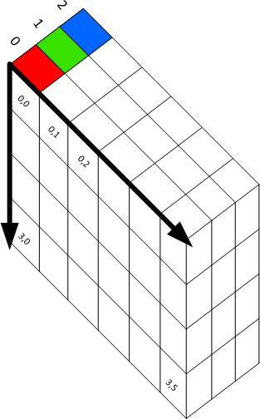
Considered 3D Volumes
3 | 3 | 0
3 | 3 | 0
3 | 3 | 0
*
=
Input Image 5 x 5 x 3
Filter or Kernel 3 x 3 x 3
Output or Feature Map 3 x 3

Slide 18
How Multiple Filters Affect Our Output
 | 3 |  | 3 |  | 0
 | 3 |  | 3 |  | 0
 | 3 |  | 3 |  | 0
3
3
0
*
=
3
3
0
3
3
0
Input Image 5 x 5 x 3
2 Filters or Kernels
3 x 3 x 3 x 2
Output or Feature Map 3 x 3 x 2

Slide 19
Calculating Output Size for 3D Conv Volumes
(n × n × n_{c}) * ( f × f × n_{c}) = (n − f + 1) × (n − f + 1) × n_{f}
(5 × 5 × 3) * (3 × 3 × 3) = 3 × 3 × 2
 | 3 |  | 3 |  | 0
 | 3 |  | 3 |  | 0
 | 3 |  | 3 |  | 0
3
3
0
*
=
3
3
0
3
3
0
Input Image 5 x 5 x 3
2 Filters or Kernels
3 x 3 x 3 x 2
Output or Feature Map 3 x 3 x 2

Slide 20
Consecutive Conv layers would keep shrinking the output
Can we preserve our image size?
We’ve added a 1 pixel pad of zeros (zero padding) around our input
0 | 0 | 0 | 0 | 0 | 0 | 0
0 | 1 | 0 | 1 | 0 | 1 | 0
0 | 1 | 0 | 0 | 1 | 1 | 0
0 | 0 | 1 | 1 | 0 | 0 | 0
0 | 1 | 0 | 0 | 1 | 0 | 0
0 | 0 | 0 | 1 | 1 | 0 | 0
0 | 0 | 0 | 0 | 0 | 0 | 0
0 | 1 | 0
1 | 0 | -1
0 | 1 | 0
*
=
7 x 7
n × n
3 x 3
f × f

Slide 21
Padding
Let’s Perform our Convolution with the Padding
0 | 0 | 0 | 0 | 0 | 0 | 0
0 | 1 | 0 | 1 | 0 | 1 | 0
0 | 1 | 0 | 0 | 1 | 1 | 0
0 | 0 | 1 | 1 | 0 | 0 | 0
0 | 1 | 0 | 0 | 1 | 0 | 0
0 | 0 | 0 | 1 | 1 | 0 | 0
0 | 0 | 0 | 0 | 0 | 0 | 0
0 | 1 | 0
1 | 0 | -1
0 | 1 | 0
*
=
7 x 7
n × n
3 x 3
f × f

Slide 22
Padding
Let’s Perform our Convolution with the Padding
0 | 0 | 0 | 0 | 0 | 0 | 0
0 | 1 | 0 | 1 | 0 | 1 | 0
0 | 1 | 0 | 0 | 1 | 1 | 0
0 | 0 | 1 | 1 | 0 | 0 | 0
0 | 1 | 0 | 0 | 1 | 0 | 0
0 | 0 | 0 | 1 | 1 | 0 | 0
0 | 0 | 0 | 0 | 0 | 0 | 0
0 | 1 | 0
1 | 0 | -1
0 | 1 | 0
*
=
7 x 7
n × n
3 x 3
f × f

Slide 23
Padding
Let’s Perform our Convolution with the Padding
0 | 0 | 0 | 0 | 0 | 0 | 0
0 | 1 | 0 | 1 | 0 | 1 | 0
0 | 1 | 0 | 0 | 1 | 1 | 0
0 | 0 | 1 | 1 | 0 | 0 | 0
0 | 1 | 0 | 0 | 1 | 0 | 0
0 | 0 | 0 | 1 | 1 | 0 | 0
0 | 0 | 0 | 0 | 0 | 0 | 0
0 | 1 | 0
1 | 0 | -1
0 | 1 | 0
*
=
7 x 7
n × n
3 x 3
f × f

Slide 24
Padding
Let’s Perform our Convolution with the Padding
0 | 0 | 0 | 0 | 0 | 0 | 0
0 | 1 | 0 | 1 | 0 | 1 | 0
0 | 1 | 0 | 0 | 1 | 1 | 0
0 | 0 | 1 | 1 | 0 | 0 | 0
0 | 1 | 0 | 0 | 1 | 0 | 0
0 | 0 | 0 | 1 | 1 | 0 | 0
0 | 0 | 0 | 0 | 0 | 0 | 0
0 | 1 | 0
1 | 0 | -1
0 | 1 | 0
*
=
7 x 7
n × n
3 x 3
f × f

Slide 25
Padding
Let’s Perform our Convolution with the Padding
0 | 0 | 0 | 0 | 0 | 0 | 0
0 | 1 | 0 | 1 | 0 | 1 | 0
0 | 1 | 0 | 0 | 1 | 1 | 0
0 | 0 | 1 | 1 | 0 | 0 | 0
0 | 1 | 0 | 0 | 1 | 0 | 0
0 | 0 | 0 | 1 | 1 | 0 | 0
0 | 0 | 0 | 0 | 0 | 0 | 0
0 | 1 | 0
1 | 0 | -1
0 | 1 | 0
*
=
7 x 7
n × n
3 x 3
f × f

Slide 26
Padding
Let’s Perform our Convolution with the Padding
0 | 0 | 0 | 0 | 0 | 0 | 0
0 | 1 | 0 | 1 | 0 | 1 | 0
0 | 1 | 0 | 0 | 1 | 1 | 0
0 | 0 | 1 | 1 | 0 | 0 | 0
0 | 1 | 0 | 0 | 1 | 0 | 0
0 | 0 | 0 | 1 | 1 | 0 | 0
0 | 0 | 0 | 0 | 0 | 0 | 0
0 | 1 | 0
1 | 0 | -1
0 | 1 | 0
*
=
7 x 7
n × n
3 x 3
f × f

Slide 27
Padding
Let’s Perform our Convolution with the Padding
Feature Map Size = Feature Map Size =
n − f + 1 = m
7 − 3 + 1 = 5
0 | 0 | 0 | 0 | 0 | 0 | 0
0 | 1 | 0 | 1 | 0 | 1 | 0
0 | 1 | 0 | 0 | 1 | 1 | 0
0 | 0 | 1 | 1 | 0 | 0 | 0
0 | 1 | 0 | 0 | 1 | 0 | 0
0 | 0 | 0 | 1 | 1 | 0 | 0
0 | 0 | 0 | 0 | 0 | 0 | 0
0 | 1 | 0
1 | 0 | -1
0 | 1 | 0
2 | 1 | -1 | 2 | 2
-1 | 1 | 3 | 2 | 1
2 | 1 | 1 | 1 | 2
1 | 1 | 1 | 0 | 2
2 | 0 | 2 | 3 | 1
*
=
7 x 7
n × n
3 x 3
f × f
5 x 5
m × m

Slide 28
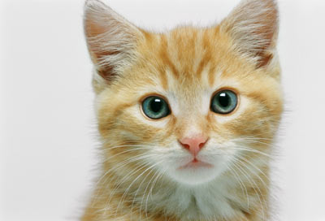
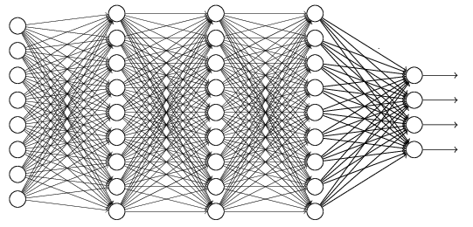
The whole CNN
cat dog ……
Convolution
Max Pooling
Can repeat many times
Fully Connected Feedforward network
Convolution
Max Pooling
Flattened

Slide 29
Example of Max Pooling
Stride = 2 Kernel = 2x2
MaxPool Operation
4 | 123 | 1 | 34
56 | 99 | 222 | 253
45 | 122 | 165 | 12
21 | 187 | 133 | 124
123 | 167
187 | 165

Slide 30
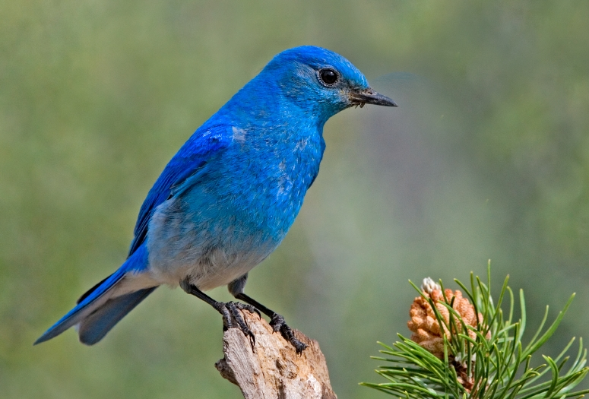

Why Pooling
Subsampling pixels will not change the object
bird
bird
Subsampling
We can subsample the pixels to make image smaller
fewer parameters to characterize the image

Slide 31
What a Stride of 1 Looks Like
1 | 0 | 1 | 0 | 1
1 | 0 | 0 | 1 | 1
0 | 1 | 1 | 0 | 0
1 | 0 | 0 | 1 | 0
0 | 0 | 1 | 1 | 0
0 | 1 | 0
1 | 0 | -1
0 | 1 | 0
2
*
=
Input Image
Filter or Kernel
Output or Feature Map

Slide 32
What a Stride of 1 Looks Like
1 | 0 | 1 | 0 | 1
1 | 0 | 0 | 1 | 1
0 | 1 | 1 | 0 | 0
1 | 0 | 0 | 1 | 0
0 | 0 | 1 | 1 | 0
0 | 1 | 0
1 | 0 | -1
0 | 1 | 0
2 | 1
*
=
Input Image
Filter or Kernel
Output or Feature Map

Slide 33
What a Stride of 1 Looks Like
1 | 0 | 1 | 0 | 1
1 | 0 | 0 | 1 | 1
0 | 1 | 1 | 0 | 0
1 | 0 | 0 | 1 | 0
0 | 0 | 1 | 1 | 0
0 | 1 | 0
1 | 0 | -1
0 | 1 | 0
2 | 1 | -1
*
=
Input Image
Filter or Kernel
Output or Feature Map

Slide 34
What a Stride of 1 Looks Like
1 | 0 | 1 | 0 | 1
1 | 0 | 0 | 1 | 1
0 | 1 | 1 | 0 | 0
1 | 0 | 0 | 1 | 0
0 | 0 | 1 | 1 | 0
0 | 1 | 0
1 | 0 | -1
0 | 1 | 0
2 | 1 | -1
-1
*
=
Input Image
Filter or Kernel
Output or Feature Map

Slide 35
What a Stride of 1 Looks Like
1 | 0 | 1 | 0 | 1
1 | 0 | 0 | 1 | 1
0 | 1 | 1 | 0 | 0
1 | 0 | 0 | 1 | 0
0 | 0 | 1 | 1 | 0
0 | 1 | 0
1 | 0 | -1
0 | 1 | 0
2 | 1 | -1
-1 | 1
*
=
Input Image
Filter or Kernel
Output or Feature Map

Slide 36
What a Stride of 1 Looks Like
1 | 0 | 1 | 0 | 1
1 | 0 | 0 | 1 | 1
0 | 1 | 1 | 0 | 0
1 | 0 | 0 | 1 | 0
0 | 0 | 1 | 1 | 0
0 | 1 | 0
1 | 0 | -1
0 | 1 | 0
2 | 1 | -1
-1 | 1 | 3
*
=
Input Image
Filter or Kernel
Output or Feature Map

Slide 37
What a Stride of 1 Looks Like
1 | 0 | 1 | 0 | 1
1 | 0 | 0 | 1 | 1
0 | 1 | 1 | 0 | 0
1 | 0 | 0 | 1 | 0
0 | 0 | 1 | 1 | 0
0 | 1 | 0
1 | 0 | -1
0 | 1 | 0
2 | 1 | -1
-1 | 1 | 3
2
*
=
Input Image
Filter or Kernel
Output or Feature Map

Slide 38
What a Stride of 1 Looks Like
1 | 0 | 1 | 0 | 1
1 | 0 | 0 | 1 | 1
0 | 1 | 1 | 0 | 0
1 | 0 | 0 | 1 | 0
0 | 0 | 1 | 1 | 0
0 | 1 | 0
1 | 0 | -1
0 | 1 | 0
2 | 1 | -1
-1 | 1 | 3
2 | 1
*
=
Input Image
Filter or Kernel
Output or Feature Map

Slide 39
What a Stride of 1 Looks Like
1 | 0 | 1 | 0 | 1
1 | 0 | 0 | 1 | 1
0 | 1 | 1 | 0 | 0
1 | 0 | 0 | 1 | 0
0 | 0 | 1 | 1 | 0
0 | 1 | 0
1 | 0 | -1
0 | 1 | 0
2 | 1 | -1
-1 | 1 | 3
2 | 1 | 1
*
=
Input Image
Filter or Kernel
Output or Feature Map

Slide 40
What about a Stride of 2?

Slide 41
What a Stride of 2 Looks Like
We start off in the same position
1 | 0 | 1 | 0 | 1
1 | 0 | 0 | 1 | 1
0 | 1 | 1 | 0 | 0
1 | 0 | 0 | 1 | 0
0 | 0 | 1 | 1 | 0
0 | 1 | 0
1 | 0 | -1
0 | 1 | 0
2
*
=
Input Image
Filter or Kernel
Output or Feature Map

Slide 42
What a Stride of 2 Looks Like
Now we jump two spots to the left
1 | 0 | 1 | 0 | 1
1 | 0 | 0 | 1 | 1
0 | 1 | 1 | 0 | 0
1 | 0 | 0 | 1 | 0
0 | 0 | 1 | 1 | 0
0 | 1 | 0
1 | 0 | -1
0 | 1 | 0
2 | -1
*
=
Input Image
Filter or Kernel
Output or Feature Map

Slide 43
What a Stride of 2 Looks Like
Now we go down, but by also 2 spots
1 | 0 | 1 | 0 | 1
1 | 0 | 0 | 1 | 1
0 | 1 | 1 | 0 | 0
1 | 0 | 0 | 1 | 0
0 | 0 | 1 | 1 | 0
0 | 1 | 0
1 | 0 | -1
0 | 1 | 0
2 | -1
2
*
=
Input Image
Filter or Kernel
Output or Feature Map

Slide 44
What a Stride of 2 Looks Like
Now we jump two spots to the left
1 | 0 | 1 | 0 | 1
1 | 0 | 0 | 1 | 1
0 | 1 | 1 | 0 | 0
1 | 0 | 0 | 1 | 0
0 | 0 | 1 | 1 | 0
0 | 1 | 0
1 | 0 | -1
0 | 1 | 0
2 | -1
2 | 1
*
=
Input Image
Filter or Kernel
Output or Feature Map

Slide 45
Stride Observations
A larger Stride produced a smaller Feature Map output
Larger Stride has less overlap
We can use stride to control the size of the Feature Map output

Slide 46
Calculating Output Size
Using Stride and Padding
Stride = 2
Padding = 0
1 | 0 | 1 | 0 | 1
1 | 0 | 0 | 1 | 1
0 | 1 | 1 | 0 | 0
1 | 0 | 0 | 1 | 0
0 | 0 | 1 | 1 | 0
0 | 1 | 0
1 | 0 | -1
0 | 1 | 0
2 | -1
2 | 1
*
=
Input Image 5 x 5
Filter or Kernel 3 x 3
n + 2p − f
n + 2p − f
5 + (2 × 0) − 3
5 + (2 × 0) − 3
(n × n) * ( f × f ) = (
+ 1) × (
+ 1) = (
+ 1) × (
+ 1) = 2 × 2
s
s
2
2

Slide 47
Calculating Output Size
Using Stride and Padding
Stride = 1
Padding = 0
1 | 0 | 1 | 0 | 1
1 | 0 | 0 | 1 | 1
0 | 1 | 1 | 0 | 0
1 | 0 | 0 | 1 | 0
0 | 0 | 1 | 1 | 0
0 | 1 | 0
1 | 0 | -1
0 | 1 | 0
2 | -1 | 1
2 | 1 | 0
1 | -1 | 1
*
=
Input Image 5 x 5
Filter or Kernel 3 x 3
n + 2p − f
n + 2p − f
5 + (2 × 0) − 3
5 + (2 × 0) − 3
(n × n) * ( f × f ) = (
+ 1) × (
+ 1) = (
+ 1) × (
+ 1) = 3 × 3
s
s
1
1

Slide 48
Calculating Output Size
When using Stride & Padding
Stride = 1
Padding = 1
0 | 0 | 0 | 0 | 0 | 0 | 0
0 | 1 | 0 | 1 | 0 | 1 | 0
0 | 1 | 0 | 0 | 1 | 1 | 0
0 | 0 | 1 | 1 | 0 | 0 | 0
0 | 1 | 0 | 0 | 1 | 0 | 0
0 | 0 | 0 | 1 | 1 | 0 | 0
0 | 0 | 0 | 0 | 0 | 0 | 0
0 | 1 | 0
1 | 0 | -1
0 | 1 | 0
2 | -1 | 1 | 1 | 0
2 | 1 | 0 | 1 | 2
1 | -1 | 1 | 0 | 1
0 | 1 | 2 | 1 | 1
2 | 0 | 1 | 0 | 2
*
=
Input Image 7 x 7
Filter or Kernel 3 x 3
n + 2p − f
n + 2p − f
5 + (2 × 1) − 3
5 + (2 × 1) − 3
(n × n) * ( f × f ) = (
+ 1) × (
+ 1) = (
+ 1) × (
+ 1) = 5 × 5
s
s
1
1
Note if we get non integer value for our output size, we found it down to the nearest integer

Slide 49
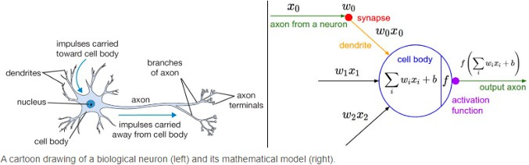
Purpose of Activation Functions
To enable the learning of complex patterns in our data
Biological neurons fire (activate) on certain inputs, these are then fed into other neurons
Introduces non-linearity to our network
This allows a non-linear decision boundary via non-linear combinations of the weight and inputs
Stanford’s CS231 Course

Slide 50
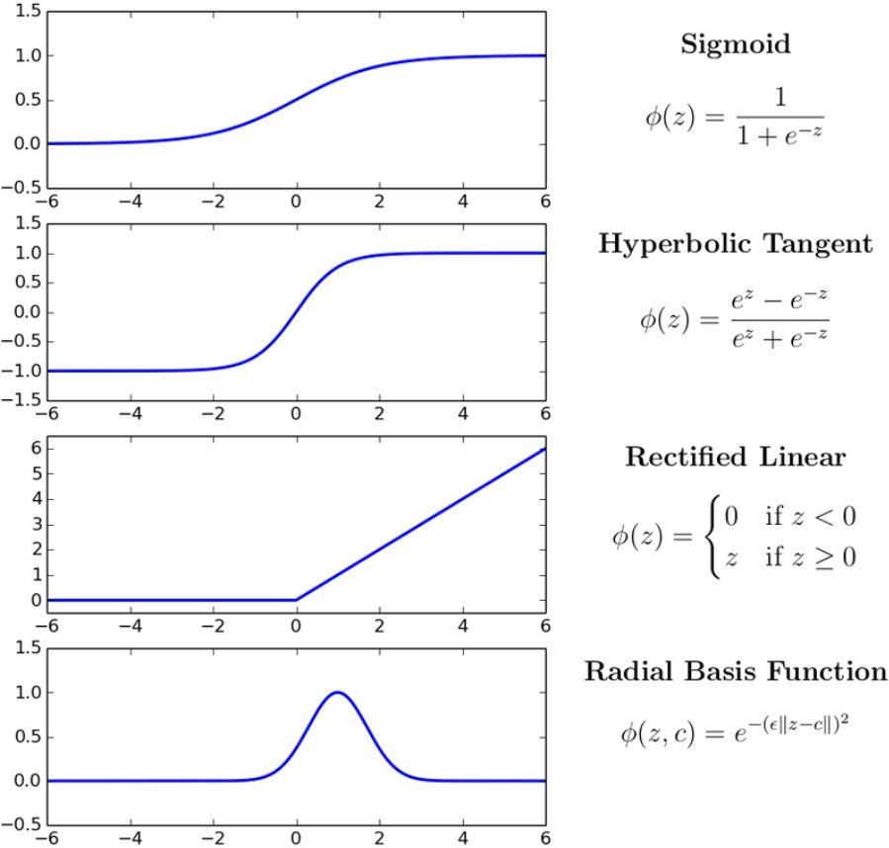
Types of Activation Functions
There are several activation functions we can use in our CNN. However, Rectified Linear Units (ReLU) have become the activation function of choice for CNNs.
ReLU is advantageous in CNN Training:
Simple Computation (fast to train)
Does not saturate

Slide 51
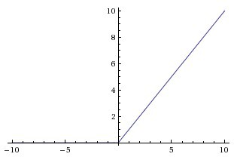
The ReLU Operation
Change all negative values to 0
Leave all positive Values alone
f(x) = max(0,x)

Slide 52
Applying the ReLU Activation
1 | 0 | 1 | 0 | 1
1 | 0 | 0 | 1 | 1
0 | 1 | 1 | 0 | 0
1 | 0 | 0 | 1 | 0
0 | 0 | 1 | 1 | 0
ReLU
0 | 1 | 0
1 | 0 | -1
0 | 1 | 0
2 | 1 | -1
-1 | 1 | 3
2 | 1 | -5
2 | 1 | 0
0 | 1 | 3
2 | 1 | 0
*
=
Input Image
Filter or Kernel
Output or Feature Map

Slide 53
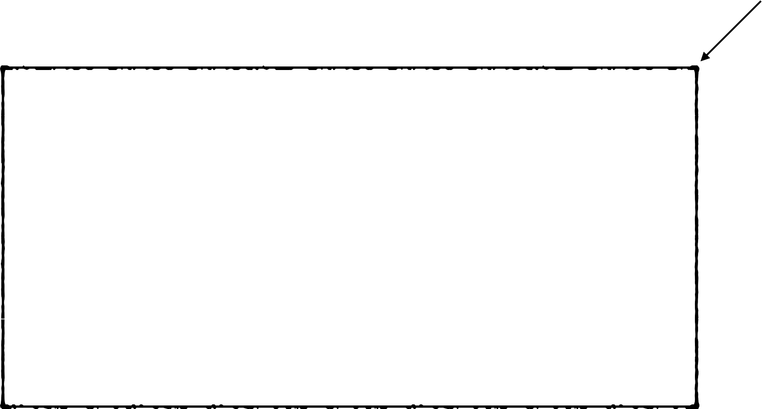
Applying the ReLU Activation
One Layer
1 | 0 | 1 | 0 | 1
1 | 0 | 0 | 1 | 1
0 | 1 | 1 | 0 | 0
1 | 0 | 0 | 1 | 0
0 | 0 | 1 | 1 | 0
ReLU
0 | 1 | 0
1 | 0 | -1
0 | 1 | 0
2 | 1 | -1
-1 | 1 | 3
2 | 1 | -5
2 | 1 | 0
0 | 1 | 3
2 | 1 | 0
*
=
Input Image
Filter or Kernel
Output or Feature Map
Rectified Feature Map

Slide 54
FC Layer - The Max Pool Layer is Flattened
Every node is connected to a node
123 | 167
187 | 165
123
167
187
165
53
45
46
222
254
111
77
16
53 | 45
46 | 222
Flattened
254 | 111
77 | 16
FC Layer

Slide 55
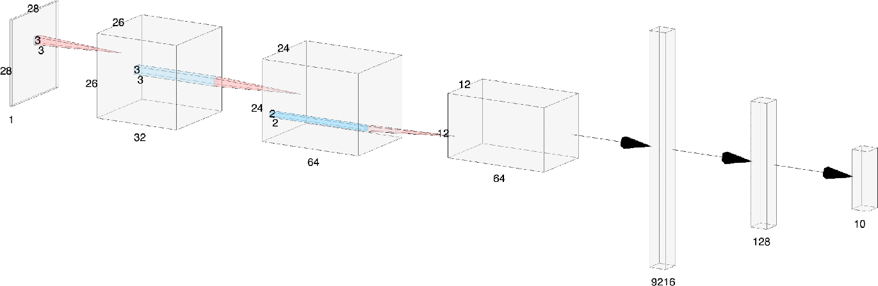

Another Representation
ReLU
Flatten
ReLU
Softmax
Input Image
Conv_1
Conv_2
Max Pool
FC
Layer | Depth | Width | Height | Filter (w) | Filter (h)
Input | 1 | 28 | 28
Conv_1 | 32 | 26 | 26 | 3 | 3
Conv_2 | 64 | 24 | 24 | 3 | 3
Max Pool | 64 | 12 | 12 | 2 | 2
Flatten | 9216 | 1 | 1
Fully Connected | 128 | 1 | 1
Output | 10 | 1 | 1
Notes:
We choose 32 & 64 Filters or Kernels for Conv_1 & Conv_2
We choose to
The Feature Maps are shown as Conv_1 and Conv_2
Stride is 1
Padding is 0 (not used)
Max Pool Stride is 2

Slide 56
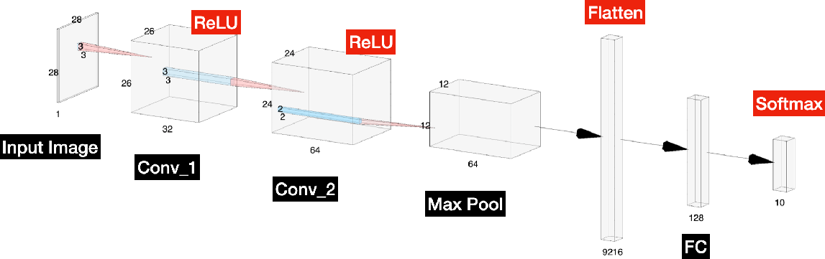
Calculating the Output Size of Conv_1
Notes:
We choose 32 Filters or Kernels for Conv_1
The Feature Maps are shown as Conv_1 & Conv_2
Stride is 1
Padding is 0 (not used)
Max Pool Stride is 2
Conv_1
n + 2p − f
n + 2p − f
28 + (2 × 0) − 3
28 + (2 × 0) − 3
(n × n) * ( f × f ) = (
+ 1) × (
+ 1) = (
+ 1) × (
+ 1) =
26 x 26
s
s
1
1
26 × 26
Where
n = 28
f = 3
s = 1
p = 0

Slide 57
Calculating the Output Size of Conv_2
Notes:
We choose 64 Filters or Kernels for Conv_2
The Feature Maps are shown as Conv_1 & Conv_2
Stride is 1
Padding is 0 (not used)
Max Pool Stride is 2
Conv_2
n + 2p − f
n + 2p − f
26 + (2 × 0) − 3
26 + (2 × 0) − 3
(n × n) * ( f × f ) = (
+ 1) × (
+ 1) = (
+ 1) × (
+ 1) =
24 x 24
s
s
1
1
24 × 24
Where
n = 26
f = 3
s = 1
p = 0

Slide 58
Calculating the Output Size of the Max Pool Layer
Notes:
We choose 64 Filters or Kernels for Conv_2
The Feature Maps are shown as Conv_1 & Conv_2
Stride is 1
Padding is 0 (not used)
Max Pool Stride is 2
Max Pool
n + 2p − f
n + 2p − f
24 + (2 × 0) − 2
24 + (2 × 0) − 2
(n × n) * ( f × f ) = (
+ 1) × (
+ 1) = (
+ 1) × (
+ 1) = 12 × 12
12 x 12
s
s
2
2
Where
n = 24
f = 2
s = 2
p = 0

Slide 59
Calculating the Output Size of Flattened Layer
Flatten
Notes:
We choose 64 Filters or Kernels for Conv_2
The Feature Maps are shown as Conv_1 & Conv_2
Stride is 1
Padding is 0 (not used)
Max Pool Stride is 2
12 × 12 × 64 =
9216
9216
Where
n = 12

